Slide 1
Building a SharePoint Document Library Approvals System

Slide 2

Greetings!
Lindsay Shelton
Application Programmer at Stowers Institute for Medical Research
Former teacher, proud cat mom
Connect with me at @lshelton_tech on Twitter!

Slide 3
The Use Case and Requirements
What did our users need?

Slide 4
Use Case
One of our departments, LAS, needed to get off an on-prem Access database system for their SOP library and approvals
This SOP library governs everything this department does, and these aren’t just internal – the entire Institute needs access to the majority of the SOPs
SOPs were just located on servers, and LAS wanted a modern solution that was cloud-based

Slide 5
Requirements
Mobile-friendly for lab members who don’t have computer access when in certain areas of the lab
Cloud-based for less-restrictive access (but still protected behind MFA and Azure AD etc.)
Multiple levels and layers of approvals required – not just one and done

Slide 6
The Basic Process
Scheduled Daily Flow
Tiered Reviews
Set Approval and Clear
Needed a scheduled flow with a recurrence trigger
Clears out all fields in the doc library that are 335 days out from their Completion Date (which also turns them back into Draft state)
At some point, had an email component to email the supervisor with info about what SOPs were up for review
Three levels of approvals – Supervisor, Member/Author, and then a group vote
Approvals are manually assigned with numbered flows and For a Selected File triggers
Group vote flow also reads SP group members and can assign approval vote to multiple groups
Approval Reminders are included and historical info is written to separate list
Clears the entries in the SP list and resets them all to null (after the group vote has written that info to a separate list)
Sets the Content Approval to Approved
Writes an approved and updated copy of the SOP to an Institute Documents library
Notes:
A basic version of the flow for the tiered individual reviews is available for download through the Microsoft Sharing is Caring community (includes error handling) - https://github.com/pnp/powerautomate-samples/tree/main/samples/request-review-and-approval-for-a-selected-file
See https://confluence.stowers.org/display/o365help/LAS+SOP+Library%3A+Initial+How+To+Guide and the actual flows for the process with comments
The Microsoft Word restriction mentioned is that it won’t let you save the file if it’s open in the app if the comments on any column are longer than 255 characters. So, we have to clear those fields and write them to the Approval Records list before the member can push reviewed changes and save the file.
Content Approval is nice because it changes to Draft the second someone makes an edit to the document, so that's why we use that versus just a custom choice field saying what the status is

Slide 7
The Most Basic Set-Up
A SharePoint document library with columns for a SupervisorReviewer (person or group), SupervisorReviewStatus (choice column, with Yes, No, and Pending), and SupervisorReviewComments (multi-line text)
https://pnp.github.io/powerplatform-samples/ and find “Request Review and Approval for a Selected File”

Slide 8
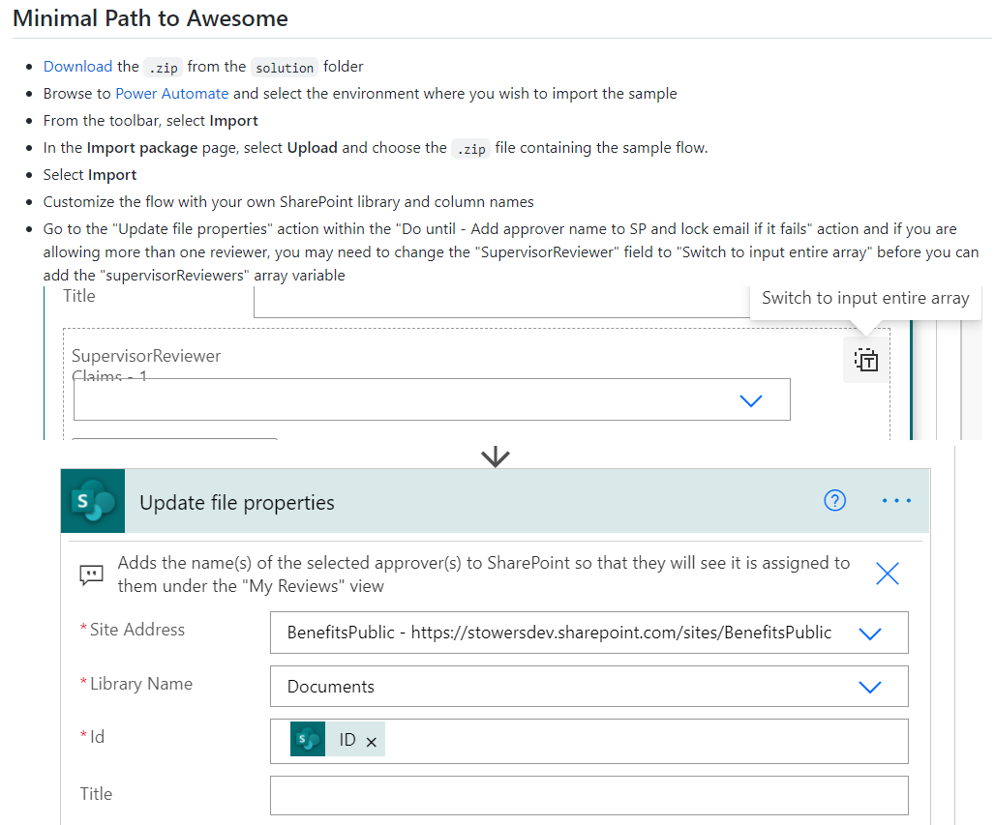
Notes:
Make.powerautomate.com, My Flows, Import Package

Slide 9
If any action needs to be done to the SharePoint Document Library, you need “file is locked” error handling if it fails

Slide 10
TO THE DEMO!

Slide 11
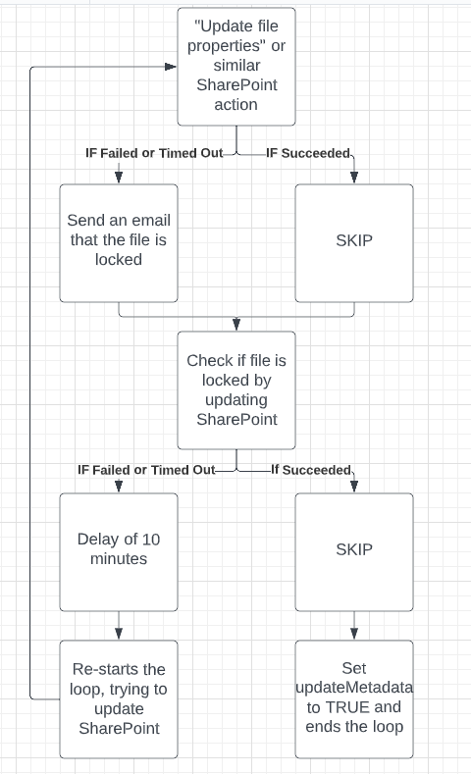

Slide 12
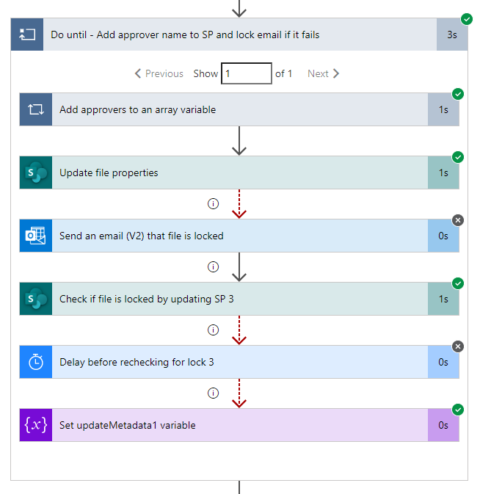
How the Error Checking should run

Slide 13
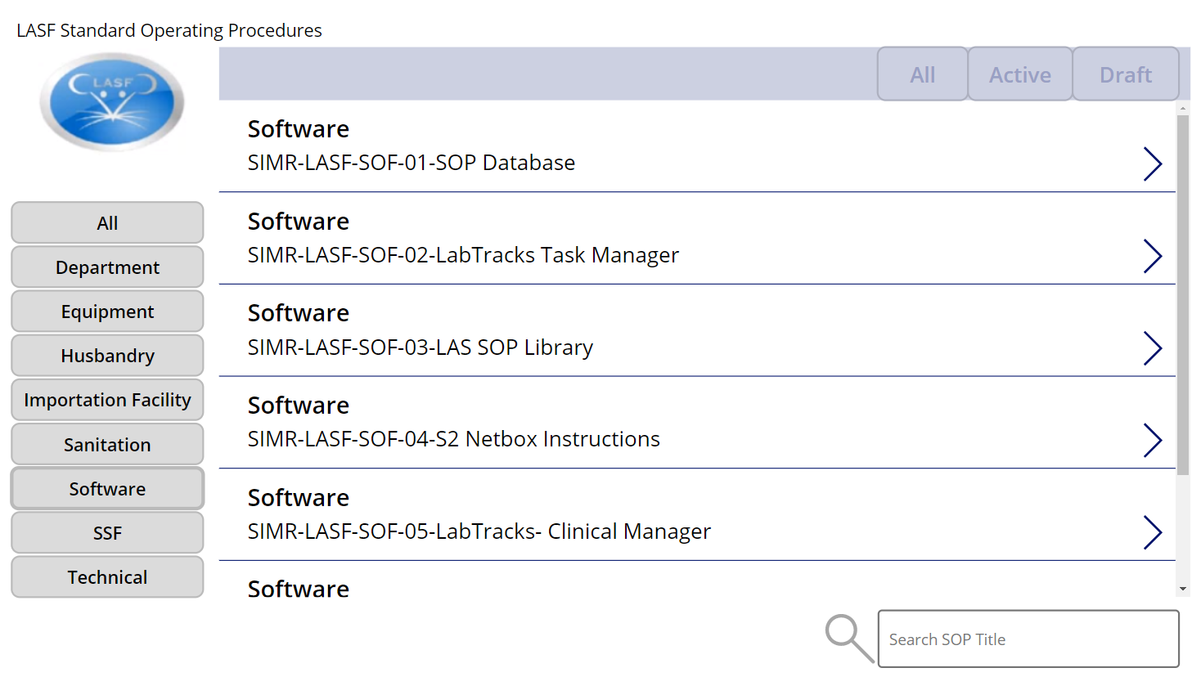
We also turned the Doc Library into a Power App!
Nothing fancy UI-wise – we designed it to mimic a legacy application they were using
In the labs, many members don’t have computer access – just phones
Still being utilized a year after launch

Slide 14
Takeaways
Make a service acct the owner of the flow and the connections, not your account. Share it with all admins.
Rename sections and leave notes, even if it’s just for future you
UAT, UAT, UAT. A lot of these tweaks you see in my code are from things that the users found when trying to do what they’d normally do

Slide 15
Source for Basic File Locked Check Pattern
https://thrivenextgen.com/power-automate-file-lock-fail/

Slide 16
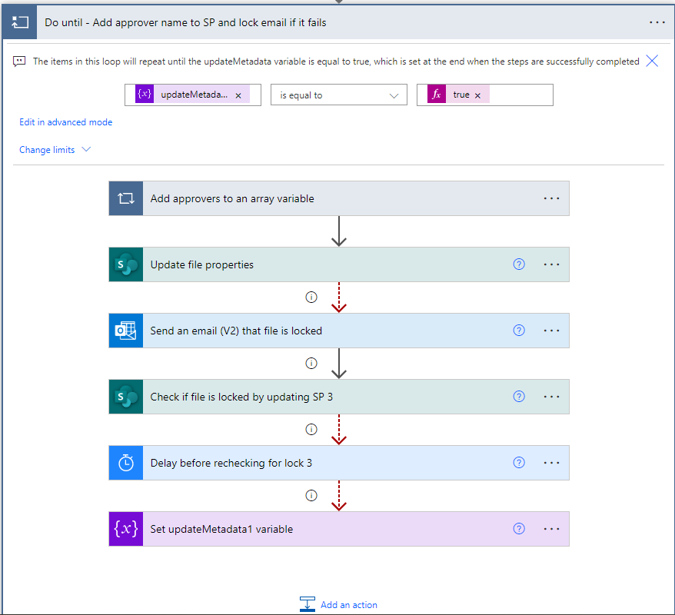

Slide 17
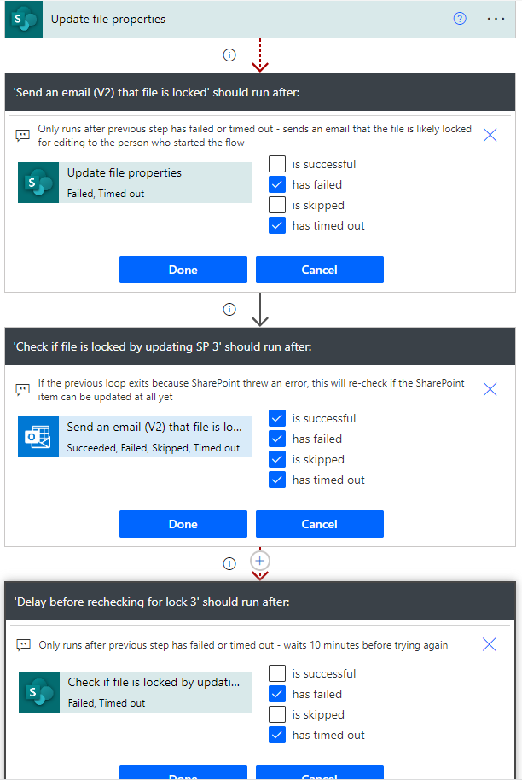
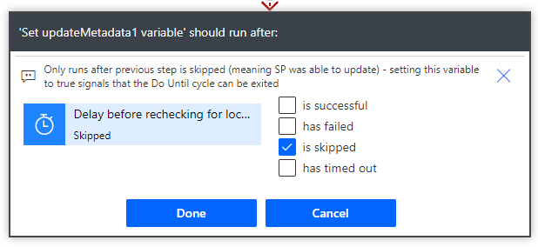

Slide 18
Demo Steps
Show getting file from the Samples Gallery
Show importing the flow
Show how to start changing the flow for your environment but then switch to Flow 1
Go through the steps of Flow 1 and show the error check loop
Go back to deck to show the Flow 1 chart
Finish going through Flow 1
Back to the deck for a few more slides

Slide 19

Free templates for all your presentation needs
For PowerPoint and Google Slides
100% free for personal or commercial use
Ready to use, professional and customizable
Blow your audience away with attractive visuals

